Slide 1
GPR Data Processing & Classification
2021.05.17

Slide 2
Contents
Filtering Result
Classification: Trained model
  Original Data set
  Sobel Filtered Data set (dx-2 dy-0)
  Laplacian Filtered Data set
  Canny Filtered Data set

Slide 3
Filtering
사용 필터
  Sobel Filter
  인접한 픽셀들의 차이로서 기울기(Gradient)를 구하여 도출
  Laplacian Filter
  2차 미분의 형태로 가장자리가 밝은 부분에서 발생한 것인지 어두운 부분에서 발생한 것인지를 구분
  Canny Filter
  Laplacian Filter를 개선한 필터. X와 Y에 대해 1차 미분 후, 네 방향으로 미분하고, 이 결과가 극대값을 갖는 지점이 가장자리가 됨
목적
  가장자리 도출(Edge Detection)
  가장자리: 전경(Foreground)와 배경(Background)이 구분되는 지점,
  (밝기가 큰 폭으로 변하는 지점을 의미)

Slide 4
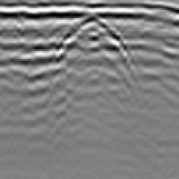
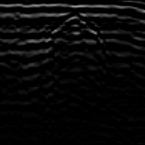
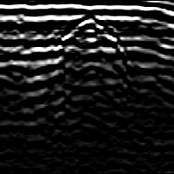



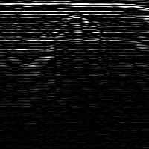
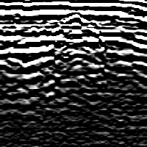

Filtering Result (1)
Sobel Filter (dx, dy)
  (0, 1)
  (0, 2)
원본
k=1
k=3
k=5
k=7
k=1
k=3
k=5
k=7

Slide 5

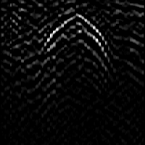


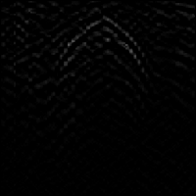
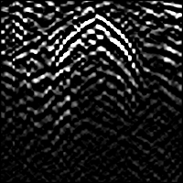

Filtering Result (2)
Sobel Filter (dx, dy)
  (1, 0)
  (1, 1)
원본
k=1
k=3
k=5
k=7
k=1
k=3
k=5
k=7

Slide 6

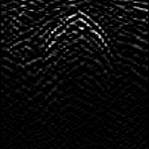
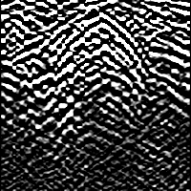




Filtering Result (3)
Sobel Filter (dx, dy)
  (1, 2)
  (2, 0)
원본
k=1
k=3
k=5
k=7
k=1
k=3
k=5
k=7

Slide 7

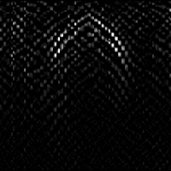
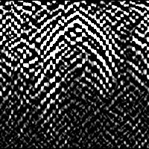


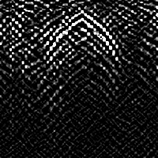
Filtering Result (4)
Sobel Filter (dx, dy)
  (2, 1)
  (2, 2)
원본
k=1
k=3
k=5
k=7
k=1
k=3
k=5
k=7

Slide 8

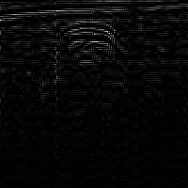


Filtering Result (5)
Laplacian Filter
Canny Filter

Slide 9

Classification
Data Set
  Labeled Data
Model
  Imagenet으로 학습된 상태의 모델에서 학습 시작
  Frozen(모델의 weight 업데이트가 불가능한 상태)된 layer 없이 작업 수행
  구현된 모델 하단에 (1024, 412, 2)인 3개의 layer 추가 부착
Imagenet
  대표적인 대규모(large-scale) 데이터셋
  1,000개의 클래스인 총 1,000,000개 이상의 데이터를 포함
  (참고) https://ndb796.tistory.com/471
 | Normal(True) | Outlier(False)
Train set | 306 | 332
Test set | 662 | 48
<Imagenet 일부>

Slide 10
Classification: Original Images
True Acc: Normal 데이터에 대한 정확도
False Acc: Outlier 데이터에 대한 정확도
Result
Model | Train |  |  | Test
 | True Acc | False Acc | Avg Acc | True Acc | False Acc | Avg Acc
VGG16 | 0.00% | 100.00% | 50.00% | 0.00% | 100.00% | 50.00%
VGG19 | 0.00% | 100.00% | 50.00% | 0.00% | 100.00% | 50.00%
ResNet50 | 98.69% | 86.45% | 92.57% | 98.49% | 100.00% | 99.24%
ResNet101 | 100.00% | 97.89% | 98.95% | 99.85% | 100.00% | 99.92%
ResNet152 | 100.00% | 0.90% | 50.45% | 100.00% | 45.83% | 72.92%
InceptionV3 | 99.02% | 99.70% | 99.36% | 99.09% | 100.00% | 99.55%
InceptionResNetV2 | 90.85% | 99.70% | 95.27% | 67.22% | 100.00% | 83.61%
MobileNet | 10.13% | 100.00% | 55.07% | 0.45% | 100.00% | 50.23%
MobileNetV2 | 3.92% | 100.00% | 51.96% | 4.83% | 100.00% | 52.42%
DenseNet121 | 97.39% | 99.40% | 98.39% | 79.91% | 100.00% | 89.95%
DenseNet169 | 100.00% | 43.07% | 71.54% | 100.00% | 100.00% | 100.00%
DenseNet201 | 100.00% | 0.00% | 50.00% | 100.00% | 20.83% | 60.42%

Slide 11
Classification: Sobel (k=1)
True Acc: Normal 데이터에 대한 정확도
False Acc: Outlier 데이터에 대한 정확도
Result
Model | Train |  |  | Test
 | True Acc | False Acc | Avg Acc | True Acc | False Acc | Avg Acc
VGG16 | 0.00% | 100.00% | 50.00% | 0.00% | 100.00% | 50.00%
VGG19 | 0.00% | 100.00% | 50.00% | 0.00% | 100.00% | 50.00%
ResNet50 | 100.00% | 0.00% | 50.00% | 100.00% | 0.00% | 50.00%
ResNet101 | 100.00% | 0.00% | 50.00% | 100.00% | 0.00% | 50.00%
ResNet152 | 100.00% | 0.00% | 50.00% | 100.00% | 0.00% | 50.00%
InceptionV3 | 80.72% | 97.29% | 89.00% | 83.84% | 97.92% | 90.88%
InceptionResNetV2 | 99.67% | 99.40% | 99.54% | 100.00% | 97.92% | 98.96%
MobileNet | 62.70% | 100.00% | 81.35% | 100.00% | 37.50% | 68.75%
MobileNetV2 | 0.65% | 100.00% | 50.33% | 0.00% | 100.00% | 50.00%
DenseNet121 | 100.00% | 75.30% | 87.65% | 100.00% | 100.00% | 100.00%
DenseNet169 | 74.84% | 99.70% | 87.27% | 72.05% | 100.00% | 86.03%
DenseNet201 | 95.75% | 97.89% | 96.82% | 100.00% | 100.00% | 100.00%

Slide 12
Classification: Sobel (k=3)
True Acc: Normal 데이터에 대한 정확도
False Acc: Outlier 데이터에 대한 정확도
Result
Model | Train |  |  | Test
 | True Acc | False Acc | Avg Acc | True Acc | False Acc | Avg Acc
VGG16 | 100.00% | 4.82% | 52.41% | 100.00% | 35.42% | 67.71%
VGG19 | 0.00% | 100.00% | 50.00% | 0.00% | 100.00% | 50.00%
ResNet50 | 99.35% | 7.23% | 53.29% | 99.85% | 14.58% | 57.22%
ResNet101 | 100.00% | 0.00% | 50.00% | 100.00% | 0.00% | 50.00%
ResNet152 | 100.00% | 0.00% | 50.00% | 100.00% | 0.00% | 50.00%
InceptionV3 | 100.00% | 98.80% | 99.40% | 100.00% | 100.00% | 100.00%
InceptionResNetV2 | 100.00% | 95.78% | 97.89% | 100.00% | 100.00% | 100.00%
MobileNet | 100.00% | 100.00% | 100.00% | 100.00% | 100.00% | 100.00%
MobileNetV2 | 22.88% | 96.08% | 59.48% | 67.98% | 91.67% | 79.82%
DenseNet121 | 20.92% | 100.00% | 60.46% | 1.96% | 100.00% | 50.98%
DenseNet169 | 97.71% | 98.49% | 98.10% | 92.90% | 100.00% | 96.45%
DenseNet201 | 91.50% | 96.99% | 94.25% | 83.69% | 100.00% | 91.84%

Slide 13
Classification: Sobel (k=5)
True Acc: Normal 데이터에 대한 정확도
False Acc: Outlier 데이터에 대한 정확도
Result
Model | Train |  |  | Test
 | True Acc | False Acc | Avg Acc | True Acc | False Acc | Avg Acc
VGG16 | 27.78% | 100.00% | 63.89% | 15.41% | 100.00% | 57.70%
VGG19 | 96.73% | 99.09% | 97.91% | 96.68% | 100.00% | 98.34%
ResNet50 | 100.00% | 68.07% | 84.04% | 100.00% | 79.17% | 89.58%
ResNet101 | 88.24% | 100.00% | 94.12% | 96.37% | 100.00% | 98.19%
ResNet152 | 100.00% | 93.37% | 96.69% | 100.00% | 77.08% | 88.54%
InceptionV3 | 91.50% | 98.80% | 95.15% | 97.43% | 100.00% | 98.72%
InceptionResNetV2 | 99.35% | 98.49% | 98.92% | 100.00% | 100.00% | 100.00%
MobileNet | 95.75% | 99.40% | 97.57% | 99.24% | 100.00% | 99.62%
MobileNetV2 | 74.18% | 100.00% | 87.09% | 76.74% | 100.00% | 88.37%
DenseNet121 | 99.67% | 96.99% | 98.33% | 100.00% | 97.92% | 98.96%
DenseNet169 | 57.19% | 99.70% | 78.44% | 45.92% | 100.00% | 72.96%
DenseNet201 | 86.93% | 100.00% | 93.46% | 84.74% | 100.00% | 92.37%

Slide 14
Classification: Sobel (k=7)
True Acc: Normal 데이터에 대한 정확도
False Acc: Outlier 데이터에 대한 정확도
Result
Model | Train |  |  | Test
 | True Acc | False Acc | Avg Acc | True Acc | False Acc | Avg Acc
VGG16 | 0.00% | 100.00% | 50.00% | 0.00% | 100.00% | 50.00%
VGG19 | 0.00% | 100.00% | 50.00% | 0.00% | 100.00% | 50.00%
ResNet50 | 74.18% | 99.70% | 86.94% | 99.24% | 91.67% | 95.46%
ResNet101 | 74.18% | 98.49% | 86.34% | 91.54% | 97.92% | 94.73%
ResNet152 | 41.83% | 96.39% | 69.11% | 87.31% | 75.00% | 81.16%
InceptionV3 | 50.33% | 68.37% | 59.35% | 8.46% | 70.83% | 39.65%
InceptionResNetV2 | 94.77% | 98.49% | 96.63% | 98.94% | 81.25% | 90.10%
MobileNet | 99.35% | 97.59% | 98.47% | 99.55% | 77.08% | 88.32%
MobileNetV2 | 38.24% | 100.00% | 69.12% | 38.97% | 100.00% | 69.49%
DenseNet121 | 87.91% | 87.05% | 87.48% | 100.00% | 64.58% | 82.29%
DenseNet169 | 51.63% | 99.70% | 75.67% | 75.68% | 100.00% | 87.84%
DenseNet201 | 9.80% | 100.00% | 54.90% | 39.12% | 100.00% | 69.56%

Slide 15
Classification: Laplician
True Acc: Normal 데이터에 대한 정확도
False Acc: Outlier 데이터에 대한 정확도
Result
Model | Train |  |  | Test
 | True Acc | False Acc | Avg Acc | True Acc | False Acc | Avg Acc
VGG16 | 100.00% | 0.00% | 50.00% | 100.00% | 0.00% | 50.00%
VGG19 | 100.00% | 0.00% | 50.00% | 100.00% | 0.00% | 50.00%
ResNet50 | 99.67% | 72.59% | 86.13% | 99.24% | 95.83% | 97.54%
ResNet101 | 100.00% | 0.00% | 50.00% | 100.00% | 0.00% | 50.00%
ResNet152 | 100.00% | 51.20% | 75.60% | 100.00% | 95.83% | 97.92%
InceptionV3 | 97.06% | 100.00% | 98.53% | 99.70% | 100.00% | 99.85%
InceptionResNetV2 | 92.48% | 94.58% | 93.53% | 99.55% | 97.92% | 98.73%
MobileNet | 100.00% | 99.70% | 99.85% | 100.00% | 100.00% | 100.00%
MobileNetV2 | 100.00% | 83.73% | 91.87% | 100.00% | 95.83% | 97.92%
DenseNet121 | 100.00% | 87.65% | 93.83% | 100.00% | 100.00% | 100.00%
DenseNet169 | 62.42% | 100.00% | 81.21% | 46.07% | 100.00% | 73.04%
DenseNet201 | 96.73% | 97.89% | 97.31% | 83.99% | 100.00% | 91.99%

Slide 16
Classification: Canny
True Acc: Normal 데이터에 대한 정확도
False Acc: Outlier 데이터에 대한 정확도
Result
Model | Train |  |  | Test
 | True Acc | False Acc | Avg Acc | True Acc | False Acc | Avg Acc
VGG16 | 0.00% | 100.00% | 50.00% | 0.00% | 100.00% | 50.00%
VGG19 | 100.00% | 0.30% | 50.15% | 100.00% | 0.00% | 50.00%
ResNet50 | 26.80% | 38.55% | 32.68% | 59.52% | 39.58% | 49.55%
ResNet101 | 100.00% | 1.81% | 50.90% | 100.00% | 0.00% | 50.00%
ResNet152 | 15.36% | 100.00% | 57.68% | 29.76% | 100.00% | 64.88%
InceptionV3 | 99.67% | 67.17% | 83.42% | 100.00% | 37.50% | 68.75%
InceptionResNetV2 | 100.00% | 64.76% | 82.38% | 100.00% | 6.25% | 53.13%
MobileNet | 99.67% | 96.69% | 98.18% | 99.85% | 83.33% | 91.59%
MobileNetV2 | 92.48% | 100.00% | 96.24% | 98.49% | 100.00% | 99.24%
DenseNet121 | 100.00% | 82.83% | 91.42% | 100.00% | 4.17% | 52.08%
DenseNet169 | 30.39% | 100.00% | 65.20% | 0.30% | 100.00% | 50.15%
DenseNet201 | 73.20% | 100.00% | 86.60% | 79.61% | 100.00% | 89.80%

Slide 17
Classification: Summary
Filter | Model | Avg. Acc
 |  | Train | Test
None | ResNet101 | 98.95% | 99.92%
 | InceptionV3 | 99.36% | 99.55%
Sobel (k=1) | InceptionResNetV2 | 99.54% | 98.96%
 | DenseNet201 | 96.82% | 100.00%
Sobel (k=3) | InceptionV3 | 99.40% | 100.00%
 | InceptionResNetV2 | 97.89% | 100.00%
 | MobileNet | 100.00% | 100.00%
 | DenseNet169 | 98.10% | 96.45%
Sobel (k=5) | InceptionV3 | 95.15% | 98.72%
 | InceptionResNetV2 | 98.92% | 100.00%
 | MobileNet | 97.57% | 99.62%
 | DenseNet121 | 98.33% | 98.96%
Sobel (k=7) | NULL | NULL | NULL
Laplician | InceptionV3 | 98.53% | 99.85%
 | MobileNet | 99.85% | 100.00%
Canny | MobileNetV2 | 96.24% | 99.24%
각 필터 별 최고 성능은 다음과 같음

Slide 18
Classification: Summary
Filter
  Sobel(k=3)
  Sobel(k=5)
Model
  InceptionV3
  InceptionResNetV2
위의 조건으로 unlabeled data에 대해 검증 필요

